Slide 1
Welcome

Slide 2
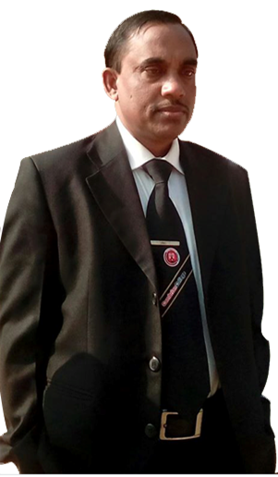
Introduction
Md. Hasan Hafizur Rahman
Lecturer & Head of the Department (English)
Cambrian School & College
Baridhara, Dhaka
English 2nd paper
Writing Part
Class VI-X

Slide 3
What do you mean by the picture and video?
A Journey by Boat
(Composition)
Let us have a discussion on it in our today’s class.

Slide 4
Learning outcomes
At the end of the lesson we will be able to-
describe a journey by boat.

Slide 5
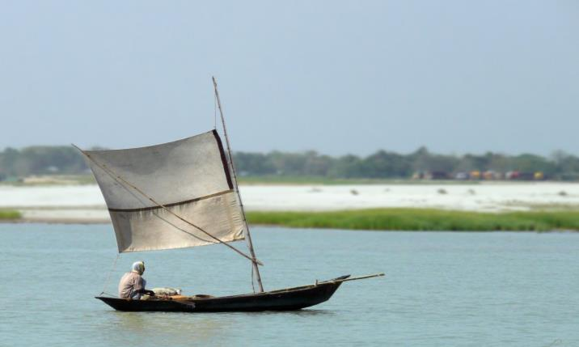
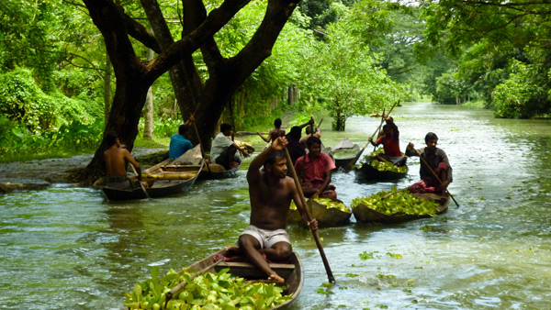
river
canal
Bangladesh is a country of ____________ and _____________.
So a ___________ by __________ is easy and cheap here.
A journey ___________ boat is also very___________.
It is ___________ risky than other ________________.
That’s why many people________________ it very much.

Slide 6
I like a journey by______________. Every year I take at least a __________
by boat. My house is at the _____________ of a river Madhumati by name.

Slide 7
Last week I took a journey by boat.

Slide 8
I and two other friends were invited to attend a
marriage ceremony of one of our friend’s sister.

Slide 9
It was about 15 kilometers away from our home.
There was no alternative way to go there without boat.

Slide 10
So we hired a boat. It was a open boat. There was an expert
boatman in our boat. The sky was somewhat cloudy. Gentle
breeze was blowing over the river.

Slide 11
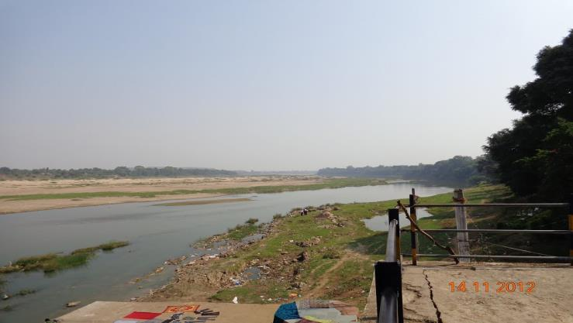
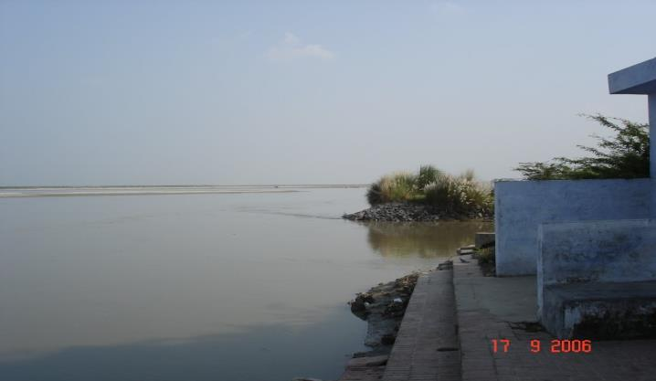
Patgati
Pirojpur
Our destination was from _____________ to ________________.
We _________our journey at half past seven in the morning.
We took some cooking _________with us. The boatman himself
was a cook.

Slide 12
Our boat began to move slowly. Gradually the boatman raised its speed.

Slide 13
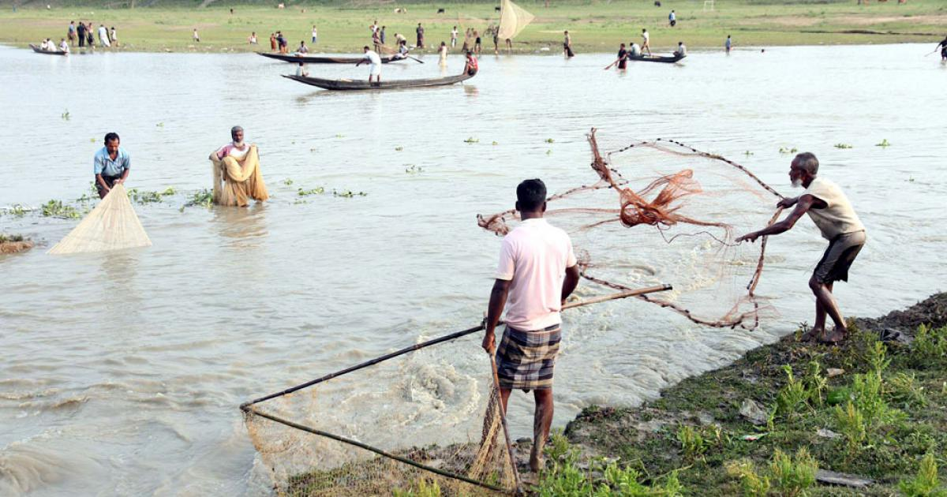
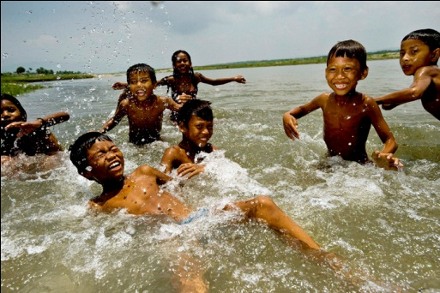
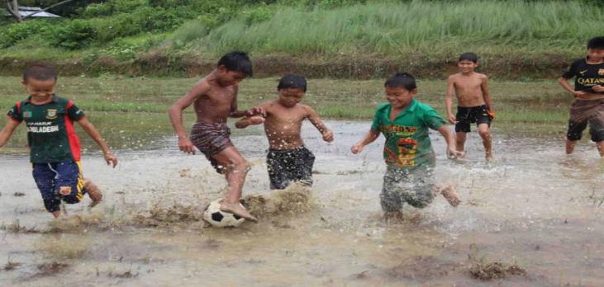
After a while we saw the children ______________ ,______________
and the fishermen______________ fishes in the river.

Slide 14
We enjoyed the green fields and paddy
fields in the both side of the river.

Slide 15
We saw the women fetching water.

Slide 16
By the by we saw a fisherman catching fishes nearby our boat. We called him and found a live hilsha fish in his boat. We bought it from the fisherman. This was the first time I saw a live hilsha fish. It was really a great pleasure to me seeing a live hilsha fish.

Slide 17
When it was 12 o'clock, our boatman cast anchor in a river bank market. We bought rice, eggs, potatoes and some spices from the market.

Slide 18
At a little distance of the market we chose a
beautiful wood place for cooking our foods.

Slide 19
When the boatman was cooking food for us, we were walking in the jungle and enjoying the natural beauty of the jungle. After an hour we enjoyed the lunch with the hilsha fish curry. How tasty the food was! We never forget it.

Slide 20
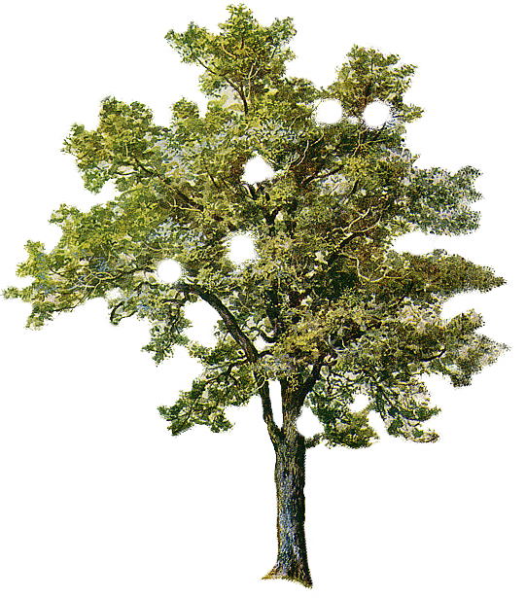
After taking rest for a while
we again started our journey.

Slide 21
The river was making little waves by the wind blowing over it. Gradually
it became afternoon. The western sky was turning into red sight in colour.

Slide 22
Enjoying the sun set we reached the destination. Though we passed a long way in the journey, we enjoyed it very much. It was a memory of life. I will never forget it.

Slide 23
Thank you all.

Slide 24
Bangladesh is a country of ____________ and _____________. So a __________ by __________ is easy and cheap here. A journey ___________ boat is also very ___________. It is ___________ risky than other ________________. That’s why many people________________ it very much. I like a journey by ______________. Every year I take at least a __________by boat. My house is at the _____________ of a river Madhumati by name. Last week I and two other friends were invited to attend a marriage ceremony of one of our friend’s sister . It was about 15 kilometers away from our home. There was no alternative way to go there without boat. So we hired a boat. It was a open boat. There was an expert boatman in our boat. The sky was somewhat cloudy. Gentle breeze was blowing over the river. Our destination was from _____________ to ________________. We _________our journey at half past seven in the morning. We took some cooking _________with us. The boatman himself was a cook. Our boat began to move slowly. Gradually the boatman raised its speed. After a while we saw the children ______________ ,__________and the fishermen______________ fishes in the river. We enjoyed the green fields and paddy fields in the both side of the river. We saw the women fetching water.

Slide 25
By the by we saw a fisherman catching fishes nearby our boat. We called him and found a live hilsha fish in his boat. We bought it from the fisherman. This was the first time I saw a live hilsha fish. It was really a great pleasure to me seeing a live hilsha fish. When it was 12 o'clock, our boatman cast anchor in a river bank market. We bought rice, eggs, potatoes and some spices from the market.
At a little distance of the market we chose a beautiful wood place for cooking our foods. When the boatman was cooking food for us, we were walking in the jungle and enjoying the natural beauty of the jungle. After an hour we enjoyed the lunch with the hilsha fish curry. How tasty the food was! We never forget it.
After taking rest for a while we again started our journey. The river was making little waves by the wind blowing over it. Gradually it became afternoon. The western sky was turning into red sight in colour. Enjoying the sun set we reached the destination. Though we passed a long way in the journey, we enjoyed it very much. It was a memory of life.

